Slide 1
Chapter 23 Estimating Volatilities and Correlations

Slide 2
Standard Approach to Estimating Volatility (page 521)
Define σ_{n} as the volatility per day between day n-1 and day n, as estimated at end of day n-1
Define S_{i} as the value of market variable at end of day i
Define u_{i}= ln(S_{i}/S_{i-1})

Slide 3
Simplifications Usually Made in Risk Management (page 522)
Set u_{i} = (S_{i} −S_{i-1})/S_{i-1}
Assume that the mean value of u_{i} is zero
Replace m−1 by m
This gives

Slide 4
Weighting Scheme
Instead of assigning equal weights to the observations we can set

Slide 5
ARCH(m) Model (page 523)
In an ARCH(m) model we also assign some weight to the long-run variance rate, V_{L}:

Slide 6
EWMA Model
In an exponentially weighted moving average model, the weights assigned to the u² decline exponentially as we move back through time
This leads to

Slide 7
To Show that Weights Decline Exponentially

Slide 8
Attractions of EWMA
Relatively little data needs to be stored
We need only remember the current estimate of the variance rate and the most recent observation on the market variable
Tracks volatility changes
0.94 is a popular choice for λ

Slide 9
GARCH (1,1) page 525
In GARCH (1,1) we assign some weight to the long-run average variance rate
Since weights must sum to 1
γ + α + β =1

Slide 10
GARCH (1,1) continued
Setting ω = γV the GARCH (1,1) model is
and

Slide 11
Example (Example 23.2, page 525)
Suppose
The long-run variance rate is 0.0002 so that the long-run volatility per day is 1.4%

Slide 12
Example continued
Suppose that the current estimate of the volatility is 1.6% per day and the most recent percentage change in the market variable is 1%.
The new variance rate is
The new volatility is 1.53% per day

Slide 13
GARCH (p,q)

Slide 14
Maximum Likelihood Methods
In maximum likelihood methods we choose parameters that maximize the likelihood of the observations occurring

Slide 15
Example 1
We observe that a certain event happens one time in ten trials. What is our estimate of the proportion of the time, p, that it happens?
The probability of the event happening on one particular trial and not on the others is
We maximize this to obtain a maximum likelihood estimate. Result: p = 0.1 (as expected)

Slide 16
Example 2
Estimate the variance of observations from a normal distribution with mean zero

Slide 17
Application to GARCH
We choose parameters that maximize

Slide 18
S&P 500 Excel Application
Start with trial values of ω, α, and β
Update variances
Calculate
Use solver to search for values of ω, α, and β that maximize this objective function
For efficient operation of Solver: set up spreadsheet so that three numbers that are the same order of magnitude are being searched for

Slide 19
S&P 500 Excel Application (Table 23.1)
Date | Day | S_{i} | u_{i}=(S_{i}−S_{i-1})/S_{i-1} | v_{i} =σ_{i}² | −ln(v_{i} ) −u_{i}² /v_{i}
18-Jul-2005 | 1 | 1221.13
19-Jul-2005 | 2 | 1229.35 | 0.006731
20-Jul-2005 | 3 | 1235.20 | 0.004759 | 0.00004531 | 9.5022
21-Jul-2005 | 4 | 1227.04 | −0.006606 | 0.00004447 | 9.0393
……. | ….. | ……. | ……….. | …………. | …………
13-Aug-2010 | 1279 | 1079.25 | −0.004024 | 0.00016327 | 8.6209
Total |  |  |  |  | 10,228.2349

Slide 20
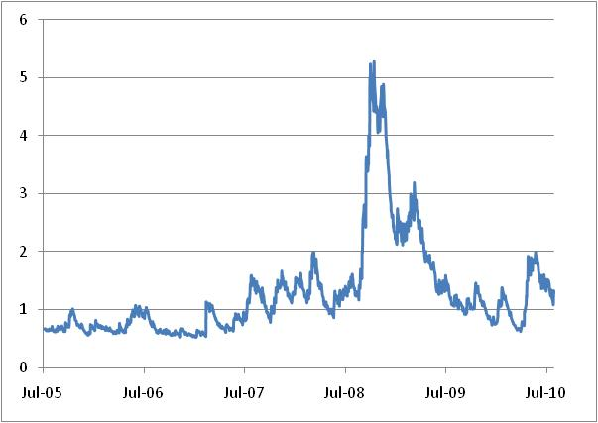
The Results (Figure 23.2, page 530)

Slide 21
Variance Targeting
One way of implementing GARCH(1,1) that increases stability is by using variance targeting
We set the long-run average volatility equal to the sample variance
Only two other parameters then have to be estimated

Slide 22
How Good is the Model?
The Ljung-Box statistic tests for autocorrelation
We compare the autocorrelation of the
u_{i}² with the autocorrelation of the u_{i}²/σ_{i}²

Slide 23
Forecasting Future Volatility (equation 23.13, page 532)
A few lines of algebra shows that
The variance rate for an option expiring on day m is

Slide 24
Forecasting Future Volatility continued (equation 23.14, page 534)

Slide 25
S&P Example
ω = 0.0000013465, α = 0.083394, β = 0.910116
Option Life (days) | 10 | 30 | 50 | 100 | 500
Volatility (% per annum) | 27.36 | 27.10 | 26.87 | 26.35 | 24.32

Slide 26
Volatility Term Structures
GARCH (1,1) suggests that, when calculating vega, we should shift the long maturity volatilities less than the short maturity volatilities
When instantaneous volatility changes by Δσ(0), volatility for T-day option changes by

Slide 27
Results for S&P 500 (Table 23.4)
When instantaneous volatility changes by 1%
Option Life (days) | 10 | 30 | 50 | 100 | 500
Volatility increase (%) | 0.97 | 0.92 | 0.87 | 0.77 | 0.33

Slide 28
Correlations and Covariances (page 535-537)
Define x_{i}=(X_{i}−X_{i-1})/X_{i-1} and y_{i}=(Y_{i}−Y_{i-1})/Y_{i-1}
Also
σ_{x,n}: daily vol of X calculated on day n−1
σ_{y,n}: daily vol of Y calculated on day n−1
cov_{n}: covariance calculated on day n−1
The correlation is cov_{n}/(σ_{x,n} σ_{y,n})

Slide 29
Updating Correlations
We can use similar models to those for volatilities
Under EWMA
cov_{n} = λ cov_{n-1}+(1-λ)x_{n-1}y_{n-1}

Slide 30
Positive Finite Definite Condition
A variance-covariance matrix, Ω, is internally consistent if the positive semi-definite condition
for all vectors w

Slide 31
Example
The variance-covariance matrix
is not internally consistent

Slide 32
Volatilities and Correlations for Four-Index on Sept 25, 2008 with Equal Weights
 | DJIA | FTSE | CAC 40 | Nikkei 225
DJIA | 1
FTSE | 0.489 | 1
CAC 40 | 0.496 | 0.918 | 1
Nikkei 225 | −0.062 | 0.201 | 0.211 | 1
 | DJIA | FTSE | CAC 40 | Nikkei 225
Vol. per day (%) | 1.11 | 1.42 | 1.40 | 1.38

Slide 33
Volatilities and Correlations for Four-Index on Sept 25, 2008 for EWMA and λ=0.94
 | DJIA | FTSE | CAC 40 | Nikkei 225
DJIA | 1
FTSE | 0.611 | 1
CAC 40 | 0.629 | 0.971 | 1
Nikkei 225 | −0.113 | 0.409 | 0.342 | 1
 | DJIA | FTSE | CAC 40 | Nikkei 225
Vol. per day (%) | 2.19 | 3.21 | 3.09 | 1.59

Slide 34
One-Day 99% VaR Estimates
Historical Simulation | $253,385
Model Building Equal Weights | $217,757
Model Building EWMA | $471,025

